Slide 1
APPLIED SCIENCE & ENGINEERING PROJECT 1(ASEP1)-PPT FOR END SEMESTER ASSESMENT - JANUARY 2026
ASEP PROJECT 1_TITLE :-Personalized Workout & Diet Planner
Div:- AI&DS-F | ASEP1_GROUP NO :- 10 | Day :- Saturday | Date :-17/01/2026
Presented by
Shlok Kumar(1251010708)
Shivangi Marmat(1251010408)
Vinay Shivaponar(1251010548)
Shravani Munde(1251010617)
Project Guide
Prof. Minal Barhate
DEPARTMENT OF ENGINEERING SCIENCES AND HUMANITIES (DESH) VISHWAKARMA INSTITUTE OF TECHNOLOGY , PUNE

Slide 2

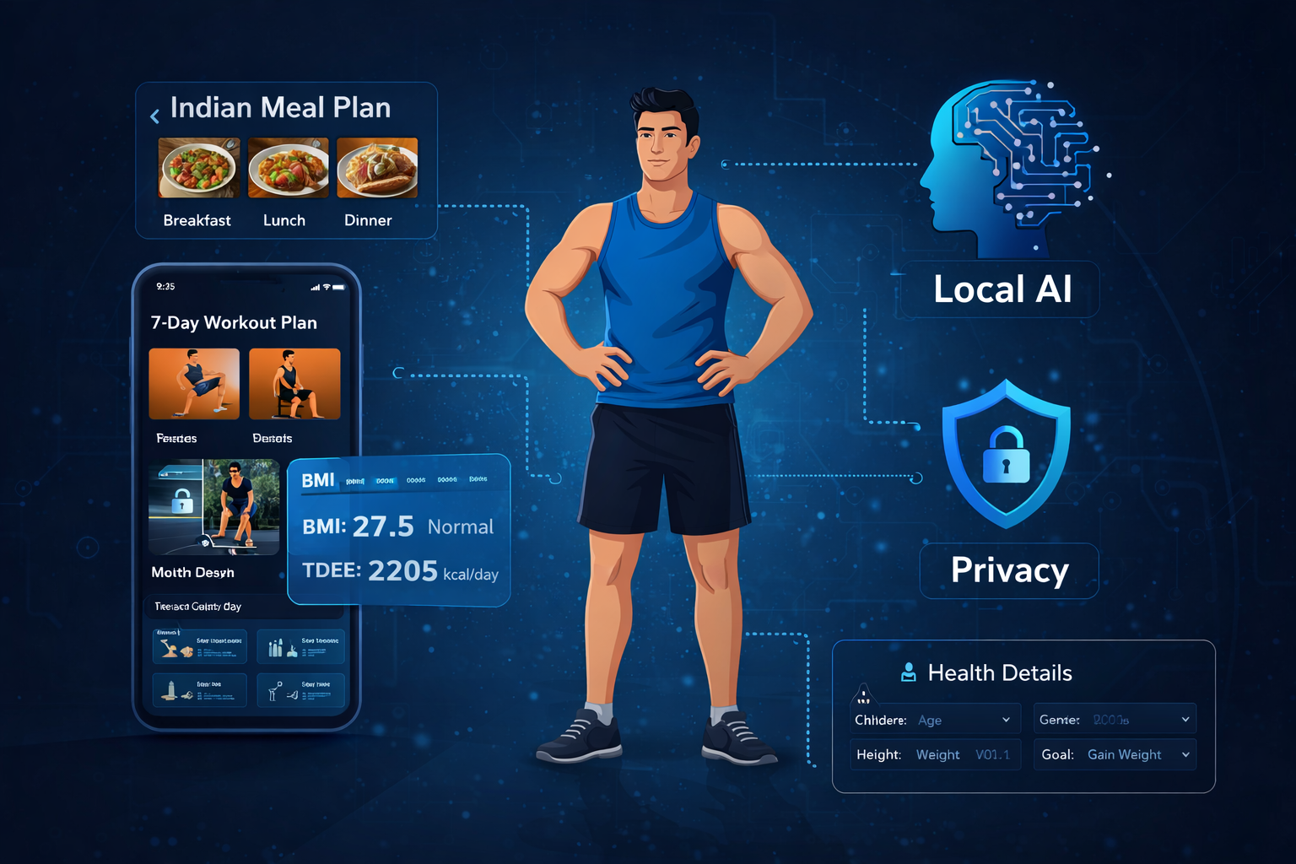
Problem Statement
Traditional fitness and diet plans are generic and one-size-fits-all, failing to account for:
Individual metabolism differences
Fitness levels and health conditions
Personal dietary preferences
This leads to low adherence, poor results,
and potential health risks.
ASEP Project - VIT Pune, DESH Department

Slide 3
Sr. No. | Paper Title | Author(s) | Year | Short Summary
1 | ML-Based Fitness | Chen & Wang | 2025 | Proposes machine learning models to personalize fitness recommendations using user activity data and performance metrics for improved accuracy.
2 | AI Nutrition Recommendation | Papastratis et | 2024 | Focuses on AI-driven dietary recommendations using user preferences and health parameters to generate adaptive nutrition plans.
3 | Genetic Insights in Fitness | Singar et al. | 2024 | Explores how genetic data can be integrated into fitness and diet systems to provide highly personalized health insights.
4 | Knowledge Graph Systems | Xu et al. | 2024 | Uses knowledge graphs to model complex relationships between food, nutrition, and health data for intelligent recommendation systems.
5 | Sequential Fitness Recommendation | Abdullah et al. | 2021 | Introduces sequential models that adapt workout plans over time based on user progress and behavior patterns.
6 | Diet Recommendation System | Swati Jadhav, | 2022 | Presents a complete SDLC-based implementation of a diet recommendation system using user activity data and rule-based logic.

Slide 4
Project Objectives
Collect and preprocess health, fitness, and nutritional data
Develop ML recommendation system for exercises and meal plans
Build constraint optimization model for macronutrient balance
Create user-friendly interface for tracking and dynamic updates
Evaluate system using accuracy, safety, and user satisfaction metrics
Methodology
Data Collection: USDA repositories and open-source health datasets
Preprocessing: Feature normalization and categorical encoding
Model Development: ML recommendation engine and linear programming optimization
Evaluation: Integration testing for safety, feasibility, and accuracy
ASEP Project - VIT Pune, DESH Department

Slide 5
Plan Configuration System
1. Data Collection : User inputs such as age, gender, weight, height, activity level, and fitness goals are collected through the web interface.Datasets related to nutrition and workouts are stored in a structured database.
2. Data Processing : Python classes handle data flow and logic implementation.Pandas is used for data cleaning, filtering, and transformation.Relevant features are selected to improve accuracy and efficiency.
3. Model & Recommendation : EngineScikit-learn is used to build and apply machine learning models.The model analyzes user data and predicts suitable diet plans and workout routines.Recommendations are generated dynamically based on user goals.
4. Plan Generation :The system combines model outputs with predefined rules to generate:Personalized diet plansCustomized workout schedules.
5. Output & Display :The final plan is displayed on the web interface in a clean and user-friendly format.Results are easy to understand and actionable for user
ASEP Project - VIT Pune, DESH Department

Slide 6
START
User Opens Web App (Frontend)
↓
User Enters Details
↓
Data Sent to Flask Backend
↓
Metric Calculations (Python Logic)
↓
Check AI Engine Status
↓
(Age, Gender, Height, Weight, Goal)
(HTML + CSS + JavaScript)
→ BMI Calculation → TDEE Calculation

Slide 7
Conclusion: Health Impact & Vision
Kinetic AI successfully demonstrates the power of Local
AI in the health sector.
It provides a cost-effective, private, and localized solution for fitness tracking.
ASEP Project - VIT Pune, DESH Department

Slide 8
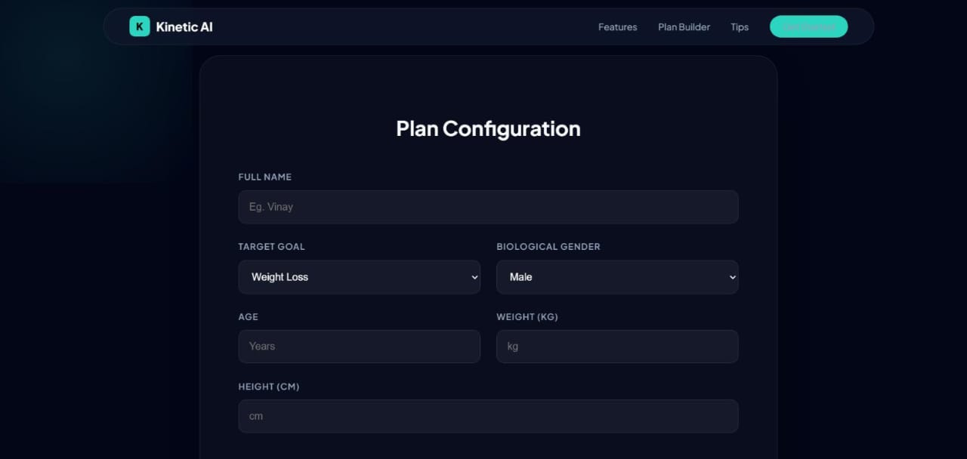
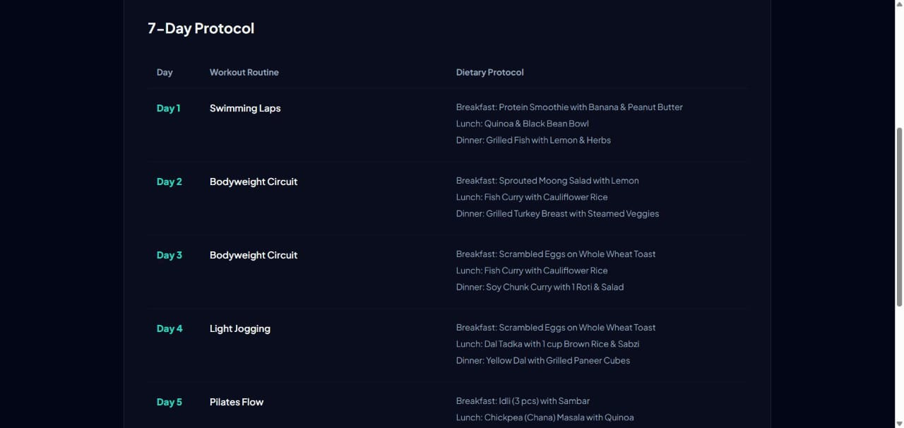
User Interface and Generated Output
ASEP Project - VIT Pune, DESH Department

Slide 9
FUTURE SCOPE :
Integration with wearable fitness devices
Progress tracking and feedback system
Mobile application development
Accurate and reliable recommendations
Scalable architecture for future enhancements
ASEP Project - VIT Pune, DESH Department

Slide 10
Thank You
Date:17/1/2026
ASEP Project - VIT Pune, DESH Department

